Slide 1

Statistical Fundamentals:
Using Microsoft Excel for Univariate and Bivariate Analysis
Alfred P. Rovai
Independent t-Test
PowerPoint Prepared by
Alfred P. Rovai
Microsoft® Excel® Screen Prints Courtesy of Microsoft Corporation.

Slide 2
Independent t-Test
The Independent t-Test, also known as Student’s t-Test and Independent Samples t-Test, is a parametric procedure that assesses whether the means of two independent groups are statistically different from each other.
Groups can be formed by randomly assigning research participants to groups or conditions in an experiment or one can use naturally occurring groups, e.g., males and females.
Excel data entry for the Independent t-Test is accomplished by entering the IV (the grouping variable) and DV (the variable that is measured) as separate columns in an Excel spreadsheet. The IV must be entered as numerical data, e.g., treatment group = 1, control group = 2.

Slide 3
Key Assumptions & Requirements
Random selection of samples to allow for generalization of results to a target population.
Variables. DV: one continuous variable, interval/ratio scale. IV: one categorical IV with two categories; e.g., group (treatment, control).
Independence of observations. Independence of observations means that observations (i.e., measurements) are not acted on by an outside influence common to two or more measurements, e.g., other research participants or previous measurements.
Normality. DV is normally distributed in each group. The Independent t-Test is robust to mild to moderate violations of normality assuming a sufficiently large sample size.
Absence of extreme outliers. Extreme outliers can distort the mean difference and the t-statistic. They tend to inflate the variance and depress the value and corresponding statistical significance of the t-statistic.
Homogeneity of variance.
Sample size. When sample sizes are large (i.e., when both groups have > 25 participants each) and are approximately equal in size, the robustness of this test to violation of the assumption of normality is improved.

Slide 4
Independent t-Test
One can compute the t-value using the following formula:
where the numerator is the difference in means of group 1 and group 2 and the denominator is the estimated standard error of the difference.

Slide 5
Independent t-Test
Cohen’s d measures effect size and is often used to report effect size following a significant t-test. The formula for Cohen’s d for the Independent t-Test is:
By convention, Cohen’s d values are interpreted as follows:
  Small effect size = .20
  Medium effect size = .50
  Large effect size = .80

Slide 6
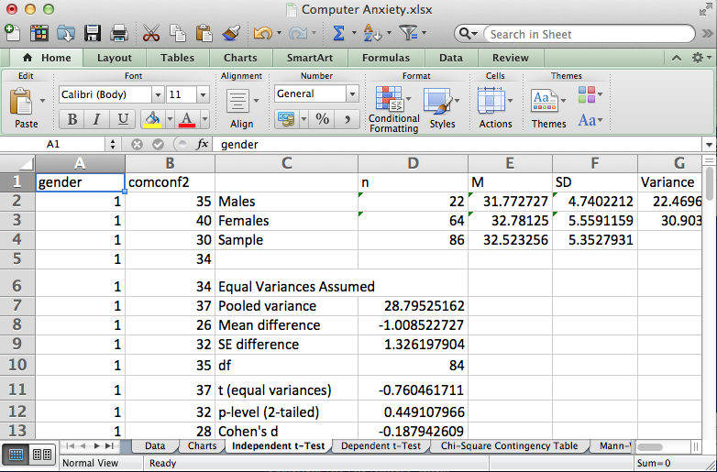
Open the dataset Computer Anxiety.xlsx. Click on the Independent t-Test worksheet tab.
File available at http://www.watertreepress.com/stats
TASK
Respond to the following research question and null hypothesis:
Is there a difference in mean computer confidence posttest between male and female university students, μ₁ ≠ μ₂?
H₀: There is no difference in mean computer confidence posttest between male and female university students, μ₁ = μ₂.
Note: for the purpose of this analysis we will assume normality. Typically, a complete analysis includes evaluation of test assumptions.

Slide 7
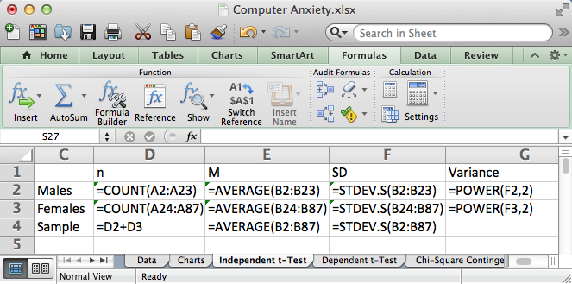
Enter the labels and formulas shown in cells C1:G4 in order to generate descriptive statistics.

Slide 8
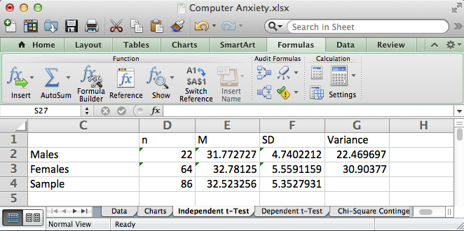
Results suggest that the groups have unequal variances (22.46 versus 30.90). Further analysis using the F-test of Equality of Variance is indicated to confirm this conclusion. Nonetheless, equal and unequal independent t-test models will be conducted. The conservative(recommended) approach is to use the unequal variance assumed results.

Slide 9
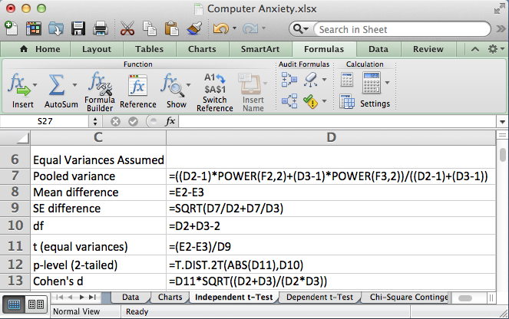
Enter the formulas shown in cells D7:D13 in order to generate independent t-test results assuming equal variances.

Slide 10
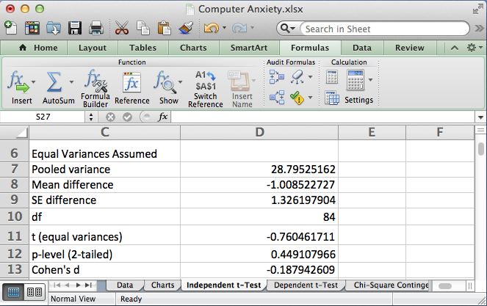
Test results assuming equal variances provided evidence that the difference in computer confidence posttest between the male group (M = 31.77, SD = 4.74) and the female group (M = 32.78, SD = 5.56) was not statistically significant, t(84) = .76, p = .45 (2-tailed), d = .19.

Slide 11
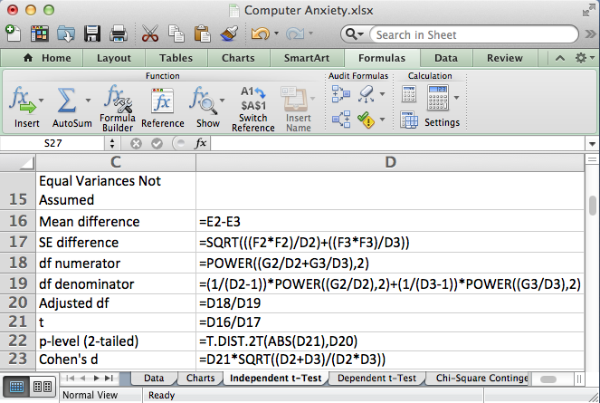
Enter the formulas shown in cells D16:D23 in order to generate independent t-test results assuming unequal variances.

Slide 12
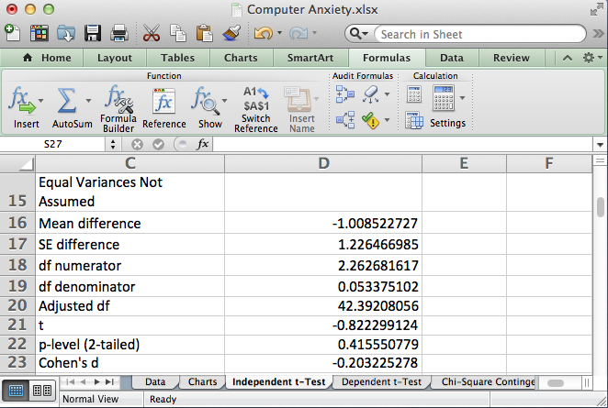
Test results assuming unequal variances provided evidence that the difference in computer confidence posttest between the male group (M = 31.77, SD = 4.74) and the female group (M = 32.78, SD = 5.56) was not statistically significant, t(42.39) = .82, p = .42 (2-tailed), d = .20.

Slide 13
Independent t-Test
End of Presentation

